Slide 1
10.2: Coverage Testing
Note: Some of these slides have been adapted from
slides freely available on the Internet and also from the
slides accompanying the course textbook.

Slide 2
Overview
Coverage Testing
Function Coverage
Statement Coverage
Branch Coverage
Condition Coverage
Coverage Testing Tools

Slide 3
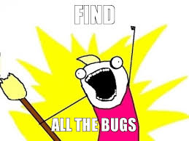



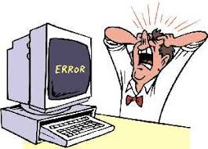
How much do we need to test?
Notes:
It is easy to spend a lot of time testing and to start to believe that you did a good job and then to have some really nasty bug show up that are triggered by parts of the input space that we just didn't think to test.

Slide 4
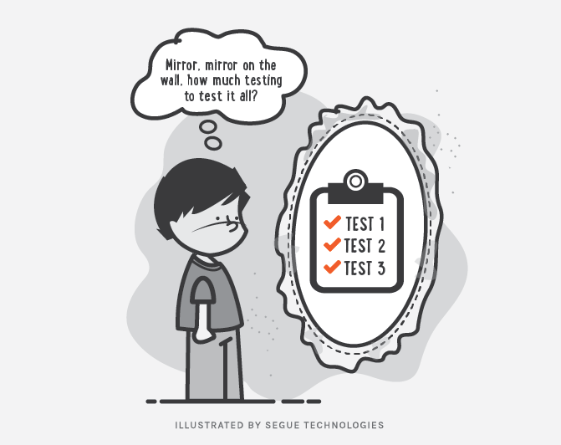
How much do we need to test?
Difficult to know
Why?

Slide 5
Domain and range
Range
Difficult to cover the whole input space
Even a small part of the input space may contain an infinite number of test cases
Domain
Error!
Missed parts may contain errors

Slide 6
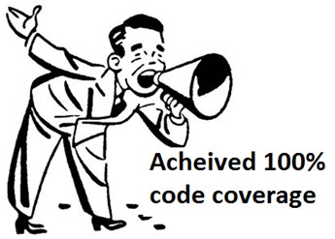
How to undertake quantitative evaluation?
https://www.codeproject.com/Articles/649815/code-coverage

Slide 7
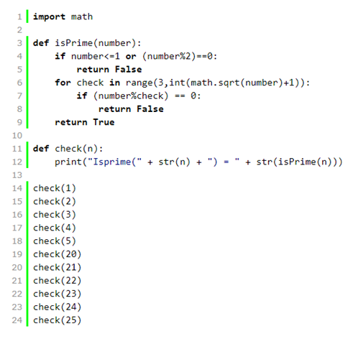
Why coverage
Testing is based on samples
Cannot run all possible tests
Need to know that all areas of design are tested
A test suite is not measured by its size
Solution: coverage analysis

Slide 8
Coverage
Code coverage is a measure used to describe the degree to which the source code of a program is executed when a particular test suite runs
The main ideas behind coverage:
Systematically create a list of tasks (the testing requirements)
Check that each task is covered during the testing

Slide 9
Example: function coverage
Function coverage is achieved if every function in the source code is executed during testing.
Domain
Range
f1()
f2()
40/50
Notes:
Test cases in the first part of the domain map to output space via f1(). Test cases in the second part of the domain maps to output space via f2(), …. We can divide the input domain for the software under test until we have split it into parts that results in every function being called. In practice, we can create a set of test cases, and run them through the software under test, and check which functions are called. The we can count 40/50 functions are called.

Slide 10
Example: function coverage
Range
Is this score good?
Look into functions that have not been covered, and figure out why and what test cases shall be used.
Dead functions
Don’t understand how system works
Domain
f1()
f2()
40/50

Slide 11
Test coverage
A program with high code coverage, measured as a percentage, has had more of its source code executed during testing which suggests it has a lower chance of containing undetected software bugs compared to a program with low code coverage.
Many different metrics can be used to calculate code coverage
the percentage of program subroutines
the percentage of program statements called during execution of the test suite.

Slide 12
Goals of coverage
Measure the "quality" of a set of tests
Supplement test specifications by pointing to untested areas
Help create regression suites
Provide a stopping criteria for unit testing

Slide 13
Value of code coverage?
Provides a quantitative measurement of the testing effort
Can assist in directing the tester's future efforts
Can demonstrate redundancy in test cases
Can be used as entry/exit criteria between test phases
Studies have demonstrated a direct correlation between increased code coverage and defect detection
100% coverage in large system is difficult to achieve
Even if 100% coverage is reached, it does not mean that the system is defect free.

Slide 14
Coverage criteria
Function coverage – Has each function in the program been called?
Statement coverage – Has each statement in the program been executed?
Branch coverage – Has each branch of each control structure (such as in if and case statements) been executed? For example, given an if statement, have both the true and false branches been executed? Another way of saying this is, has every edge in the program been executed?
Condition coverage (or predicate coverage) – Has each Boolean sub-expression evaluated both to true and false?

Slide 15
Python coverage tool
https://coverage.readthedocs.io/en/v4.5.x/

Slide 16
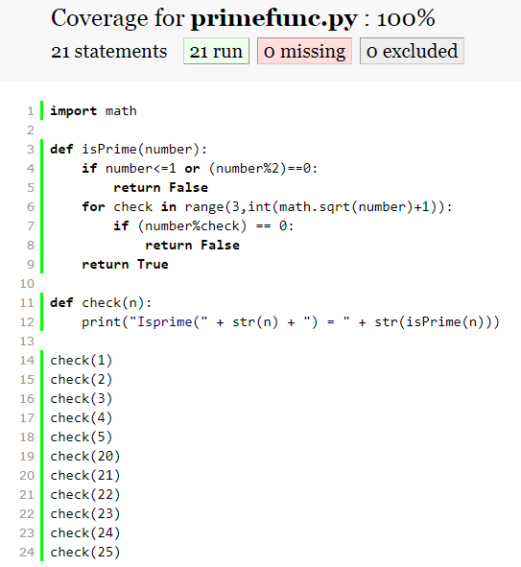
Example: prime number function
test primefunc.py
coverage run primefunc.py
coverage html -i
--branch

Slide 17
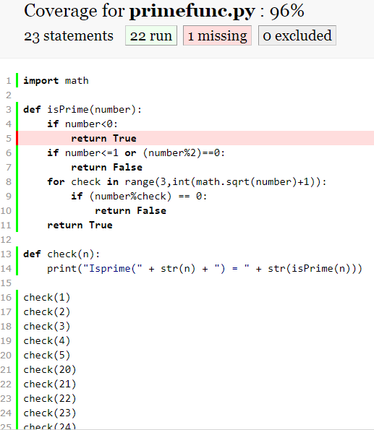
Example: prime number function
Missed statement

Slide 18
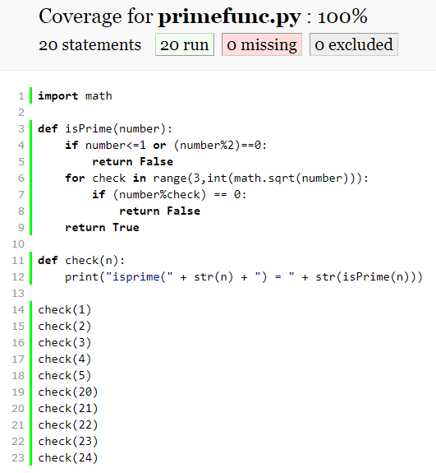
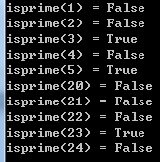
Example: prime number function
Problem with coverage

Slide 19
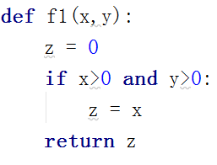
Different coverages
Assume this function is a part of some bigger program and this program was run with some test suite.
If during this execution function f1(x,y) was called at least once, then function coverage for this function is satisfied.
Statement coverage for this function will be satisfied if it was called e.g. as f1(1,1), as in this case, every line in the function is executed including z = x;.

Slide 20
Different coverages
Tests calling f1(1,1) and f1(0,1) will satisfy branch coverage because, in the first case, the 2 if conditions are met and z = x is executed, while in the second case, the first condition x>0 is not satisfied, which prevents executing z = x;.
Condition coverage can be satisfied with tests that call f1(1,0) and f1(0,1). These are necessary because in the first cases, x>0 evaluates to true, while in the second, it evaluates false. At the same time, the first case makes y>0 false, while the second makes it true.

Slide 21
Different coverages
Loop coverage: number of times that a loop is executed
for line in open(“text.txt”): print(line)
Modified condition/decision (MC/DC) coverage: for safety critical software, e.g., airplane control
Start with branch coverage
Every condition involved in a decision takes on every possible outcome
Conditional are boolean valued variables found in tests
Decisions are tests in an if statement or a while loop
e.g. if A or (B and C) – use a boolean table

Slide 22
Different coverages
Path coverage: how you get to a piece of code
def f1(x,y,z):
if x: …
if y: …
if z: …
return …
Boundary value coverage: certain values whose change result in change of outcome. E.g., legal age to have a license; boundaries in primefunc.py
8
How many paths?

Slide 23
Different coverages
Concurrent software test: two actions happen at the same time, race condition, deadlock
Synchronization coverage: make sure the deadlock works

Slide 24
When coverage does not work
It is difficult to detect omissions
E.g. hard disk is full when writing a file to the disk
Need to figure out other solutions
Fault injection – e.g. make a hard disk fail
Partition the input domain in a different way
Use specification rather than automatic coverage

Slide 25
Codes not covered
Infeasible: never going to get executed
If x>0 and x<0: print(x)
Not worthwhile
Same function tested in other tasks
Inadequate test suite
Improve the test suite
Deliver the product for cost-benefit issue

Slide 26
How to use coverage
feedback
high coverage
good
testing
measure coverage
low
coverage
rethink strategy
Notes:
High coverage: use feedback to improve the quality of test suite.
Low coverage: scenario 1: web application, users help to test. Can check log and improve the system. 2. Critical software, e.g. aviation control, figure out a better way of improving control.

Slide 27
Automatic test generation and coverage
Main goal is to improve biasing
Working with feedback (closed loop)
Avoiding the risk of specific biasing

Slide 28
Random test
Random testing is a black-box software testing technique where programs are tested by generating random, independent inputs.
Results of the output are compared against software specifications to verify that the test output is pass or fail.
In case of absence of specifications, the exceptions of the language are used which means if an exception arises during test execution then it means there is a fault in the program.

Slide 29
Random test
Automatic
Software under test
pseudorandom number generator
random test case generator
oracle
good
bad
seed
domain knowledge
further analysis
Notes:
Fixing seed leads to fixed sequence of random numbers

Slide 30
Pros and Cons
Pros:
Easily estimating software reliability from test outcomes. Test inputs are randomly generated according to an operational profile, and failure times are recorded.
Do not have bias: unlike manual testing, it does not overlook bugs because there is misplaced trust in some code.
Use of random test inputs may save some of the time and effort
Cons
Semantically redundant inputs
Can only find basic bugs
Effective oracle is seldom available

Slide 31
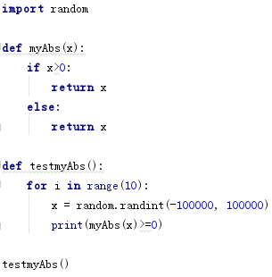
Examples

Slide 32
Rule based
Try to reduce redundancy
Use rules
Try boundary cases
Use distributions
Generate random values following certain distribution
Very effective if the distribution of input is known (e.g., age of alumni)

